Slide 1
Project Proposal
Proteome Screen: RNA-binding proteins in non-synchronized HeLa cells
Topic 3, Group 1
Julian Baureis, Julia Ferdin, Benjamin Nicklas, Luisa Wintel
Supervisor: Maiwen Caudron-Herger

Slide 2
Detection of all RNA-dependent proteins, that interact direclty or indirectly with RNA
Proteome-wide, unbiased, enrichment-free screen
Vorteile: Enrichment-free: Basiert nicht auf den Unterschieden von Affinität oder Eigenschaften der einzelnen Proteine, auch nicht auf bestimmten RNA/Protein-Sequenzen, liefert quantitative Aussagen über den Anteil jedes RBP, der tatsächlich an die RNA angelagert ist
Limitationen: Identifiziert nicht die binding sites, keine Unterscheidung zwischen direkten und indirekten Interaktionen

Slide 3
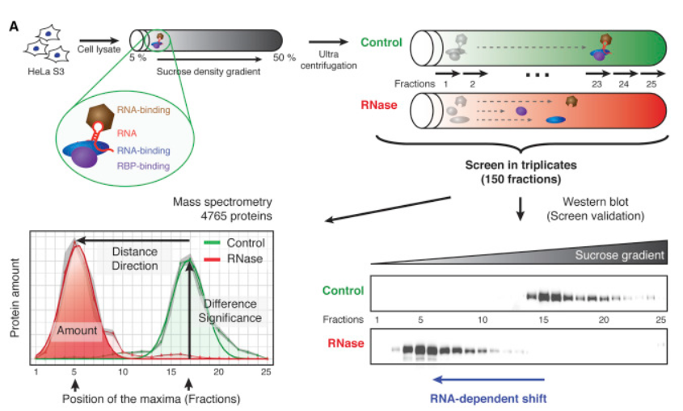
R-DeeP – Principle
RNA degradation leads to dissolved RNP- complexes
Released proteins migrate into different density fractions
Elucidation of altered migration by western blotting or mass spectrometry
Identify the quantity of peptides in the individual density fractions of control and RNase
An RNA-dependent protein must exhibit a significant shift
Adapted from: Caudron-Herger, M., Rusin, S.F., Adamo, M.E., Seiler, J., Schmid, V.K., Barreau, E., Kettenbach, A.N., and Diederichs, S. (2019). R-DeeP: Proteome-wide and Quantitative Identification of RNA-Dependent Proteins by Density Gradient Ultracentrifugation. Molecular Cell 75, 184-199.e110.

Slide 4
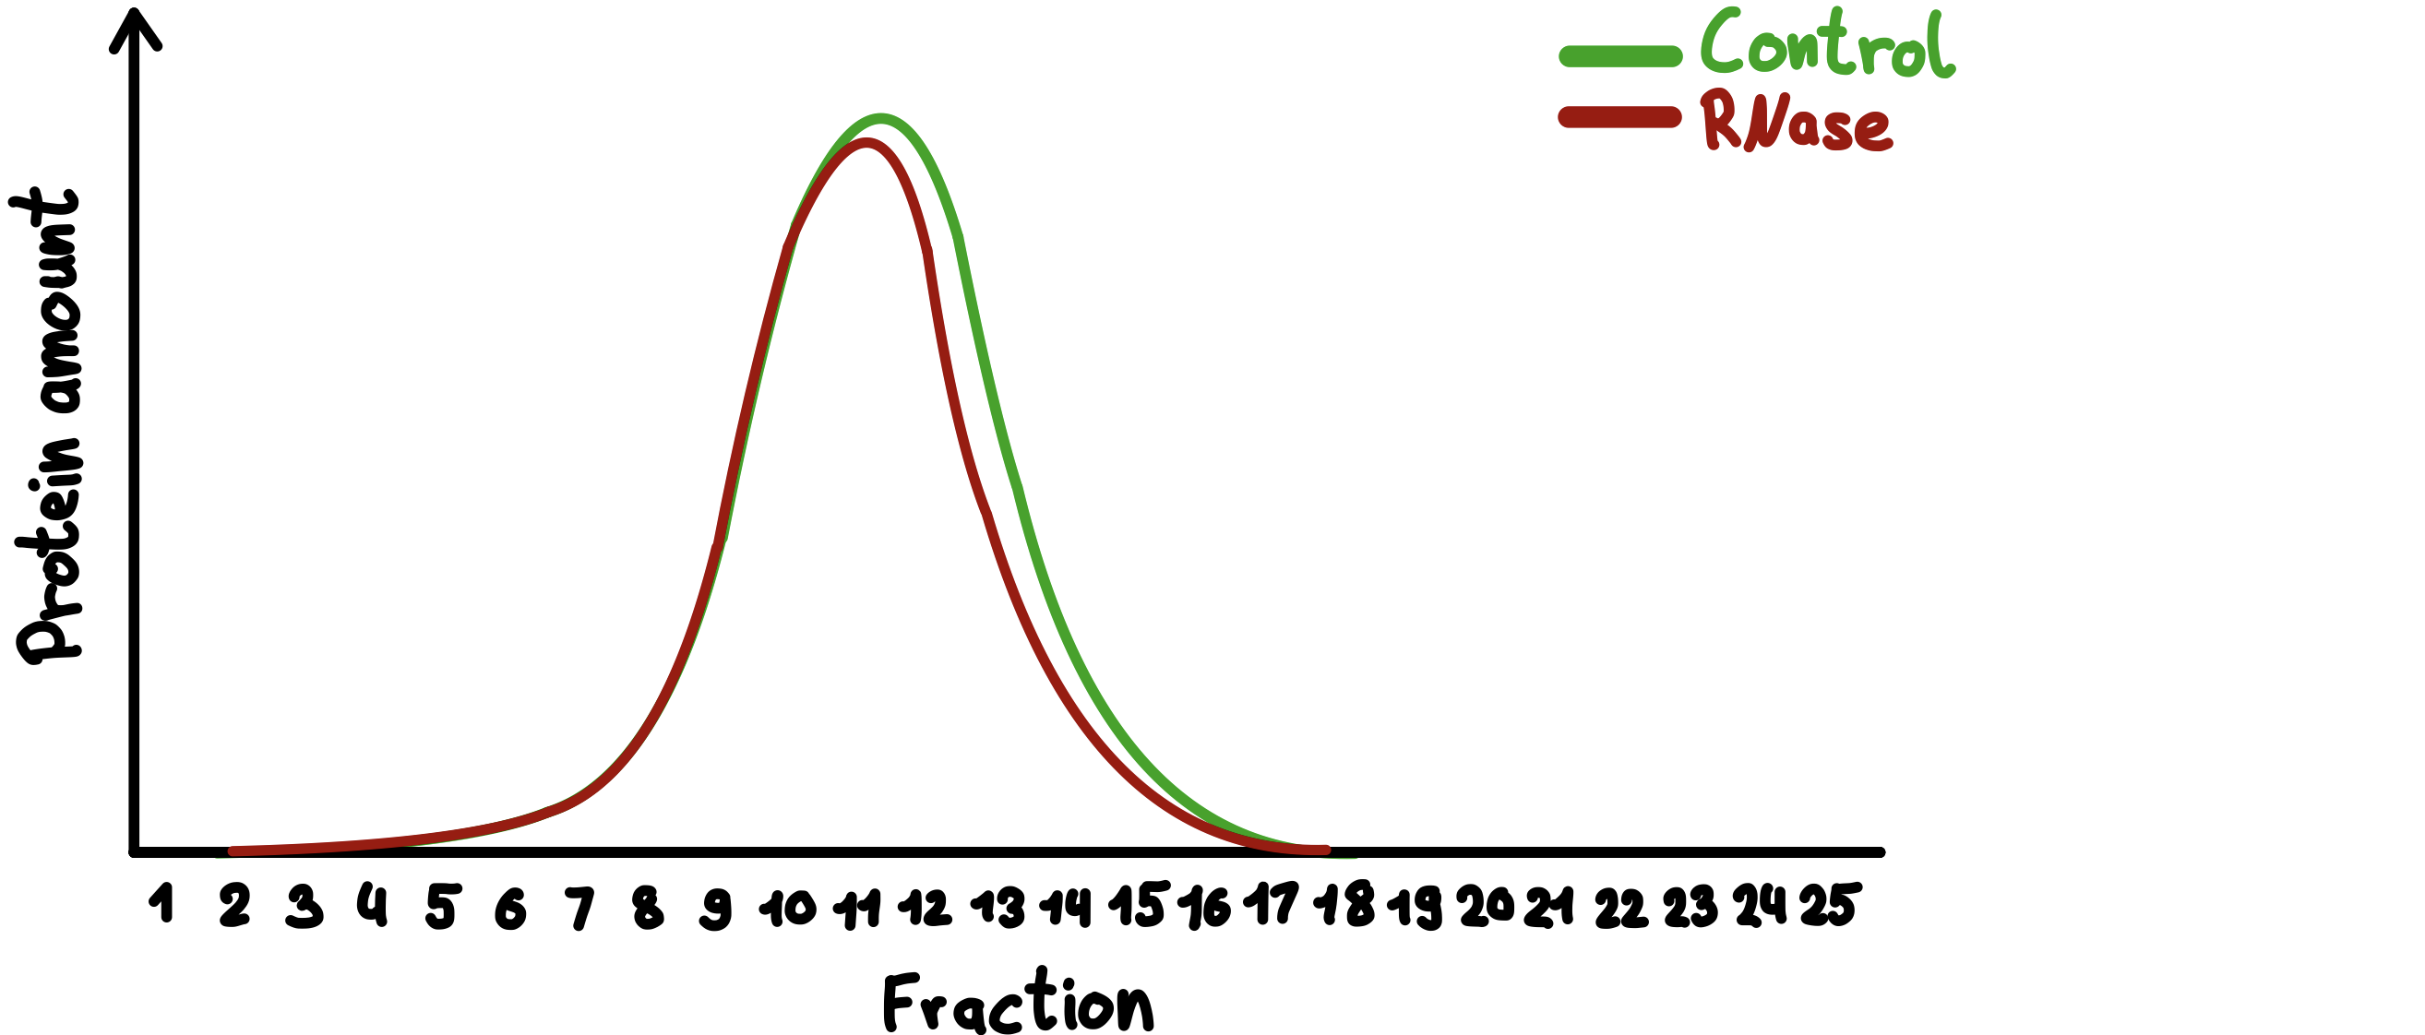
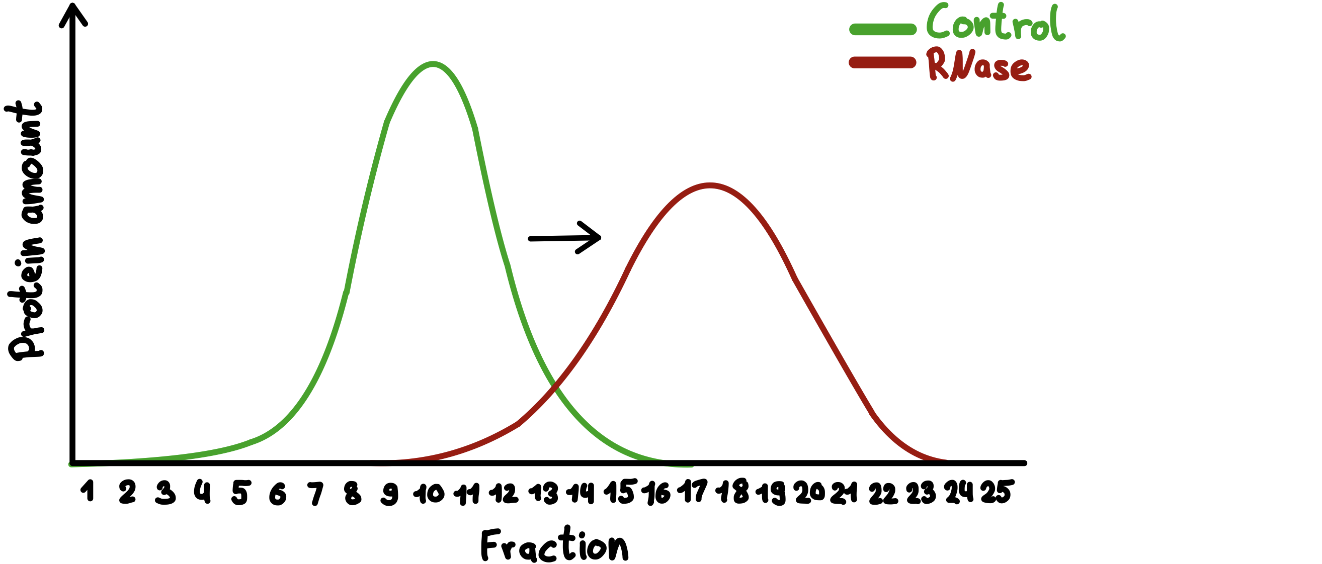
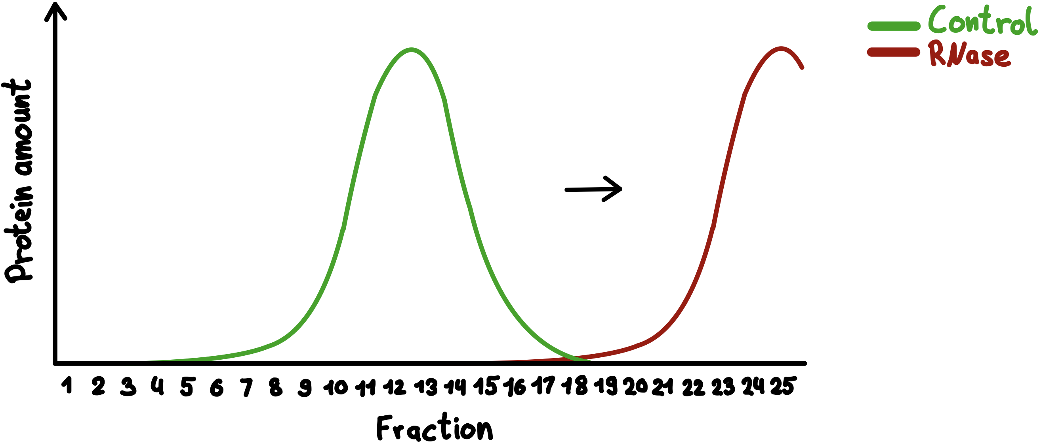
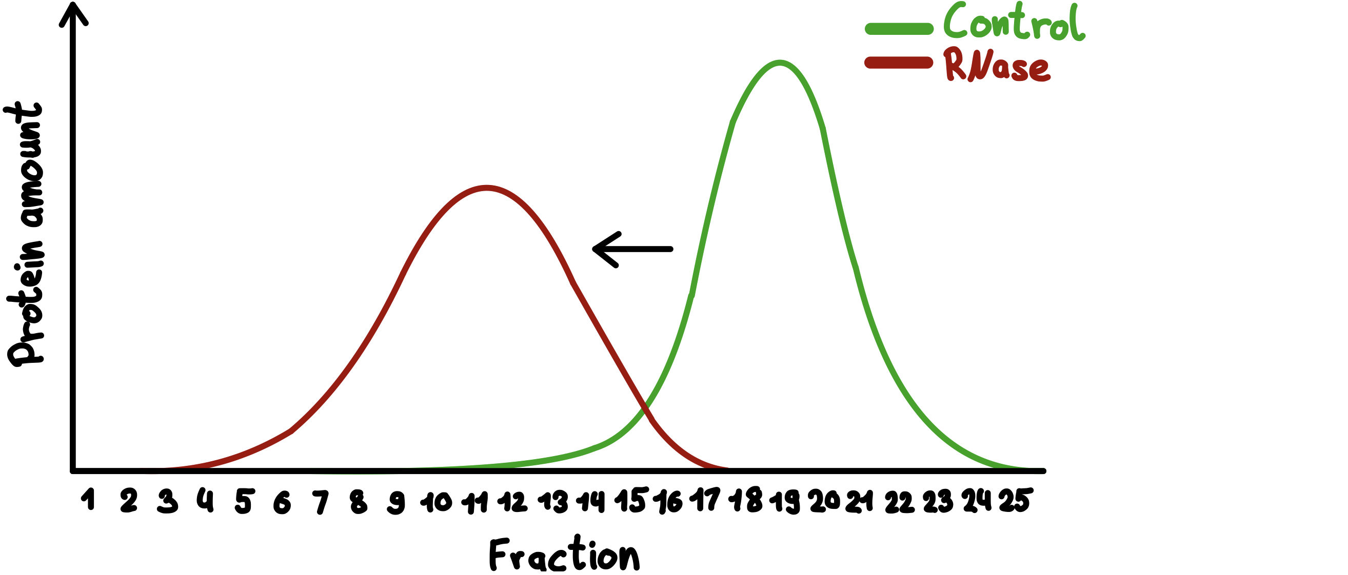
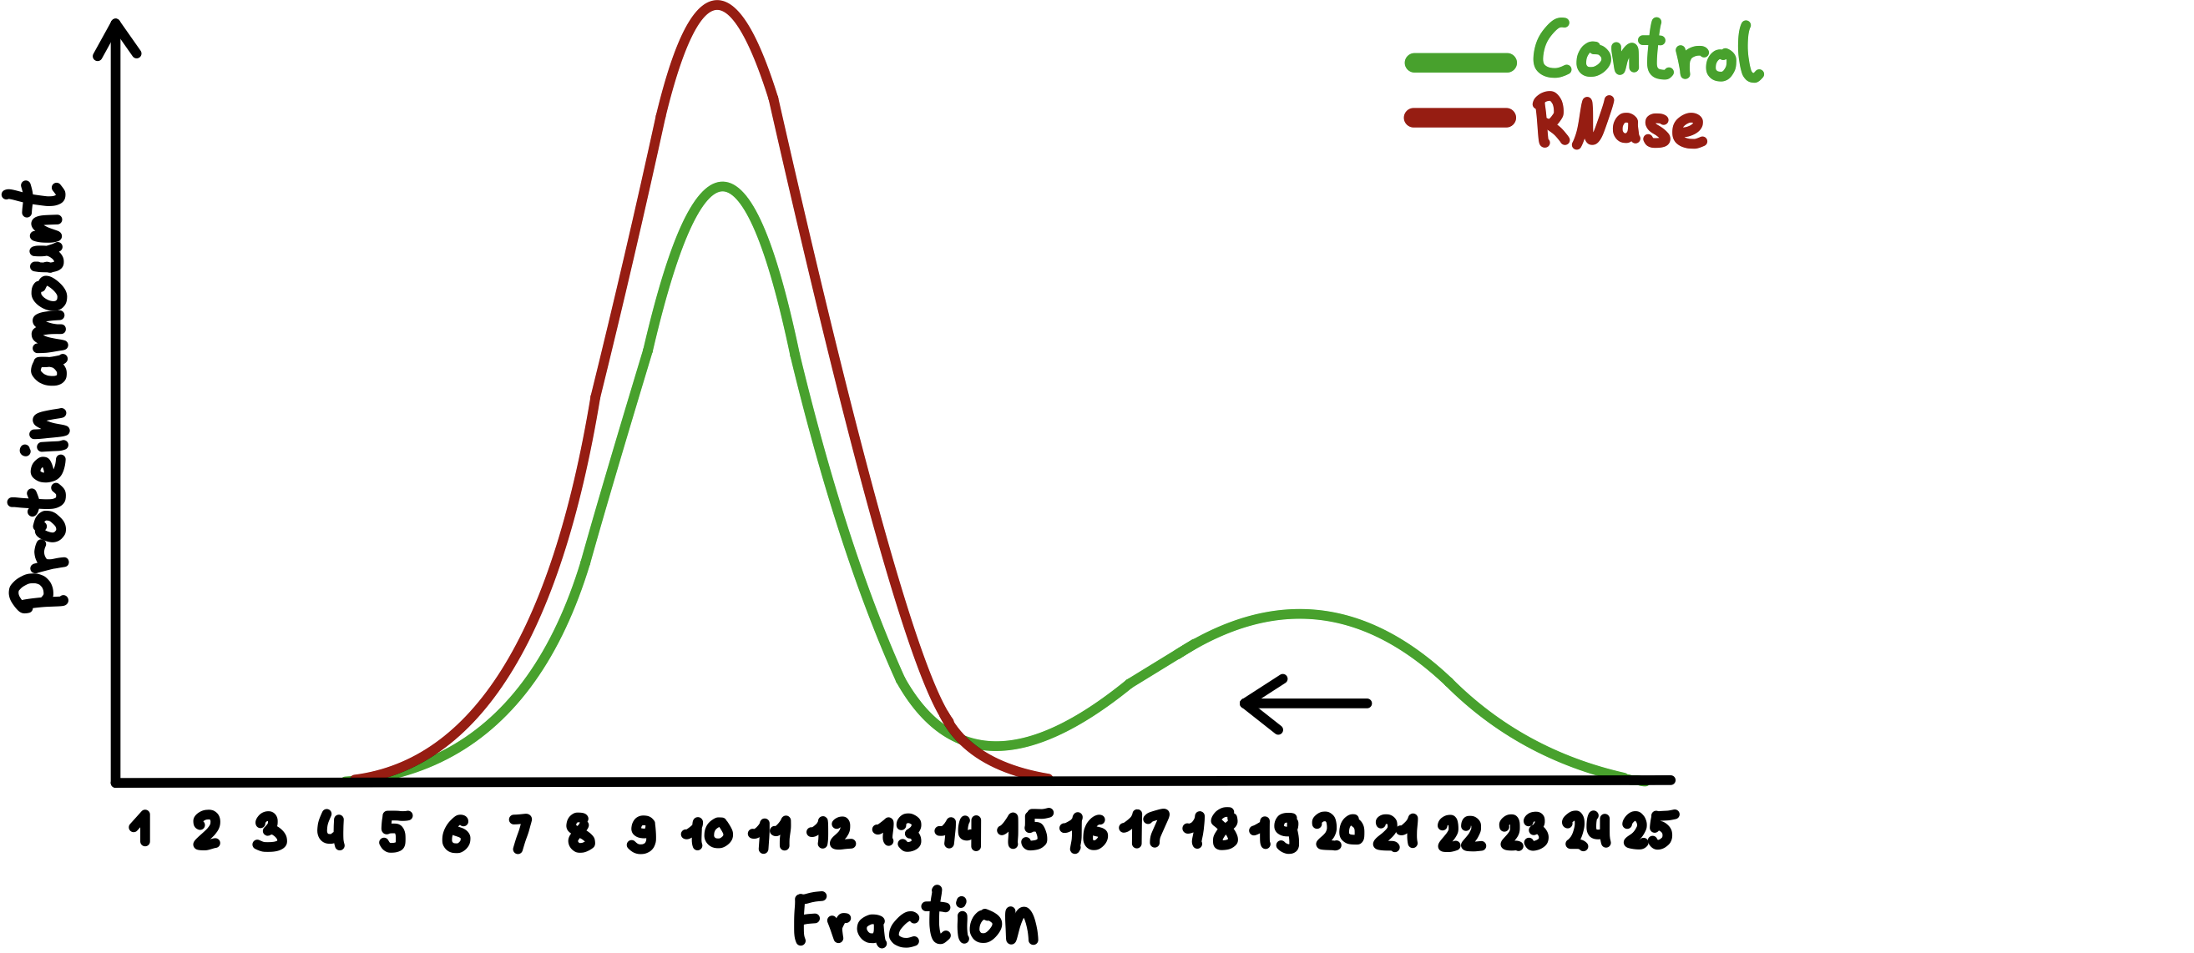
Meaning of the shifts
= apparent molecular weight changed
No shift
Right shift
precipitated
Classification of Proteins:
1. RNA-dependent
2. Partially RNA-dependent
3. Not RNA-dependent
Left shift
Partial shift

Slide 5
What is our data set showing?
Control and RNase fractions 1-25 in triplicates
Dimension: 4765 x 150
Different Proteins
Shows mass spectrometric quantitative results per protein per fraction
Allows relative comparison of the occurence of proteins in the different fractions
→ Differences in Control- and RNase-samples?

Slide 6
Which proteins in the non-synchronized HeLa cells are RNA-dependent proteins?

Slide 7
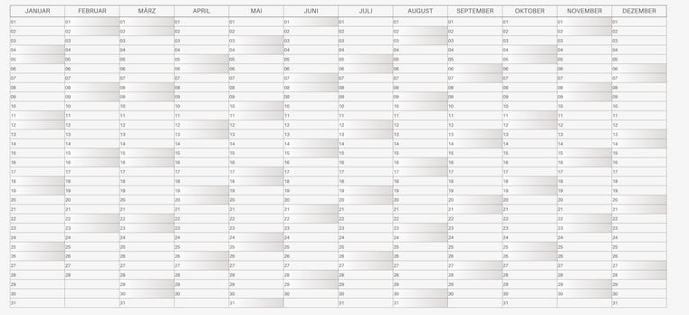
Time Table
https://www.google.com/url?sa=i&url=https%3A%2F%2Fwww.canva.com%2Fde_de%2Fkalender%2Fvorlagen%2F&psig=AOvVaw155hoQifX2EsWfPgBXsQLG&ust=1747057183090000&source=images&cd=vfe&opi=89978449&ved=0CBQQjRxqFwoTCIiCqKzFm40DFQAAAAAdAAAAABAE

Slide 8
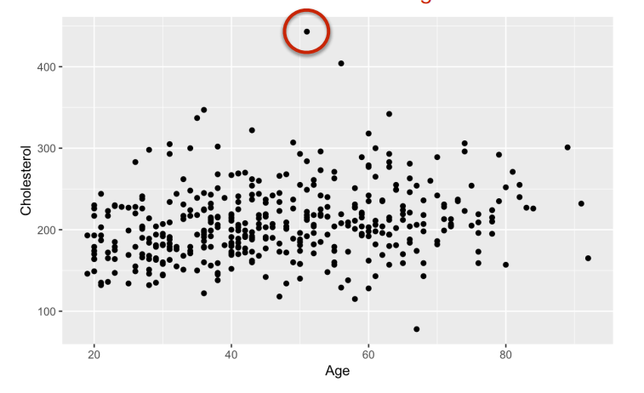
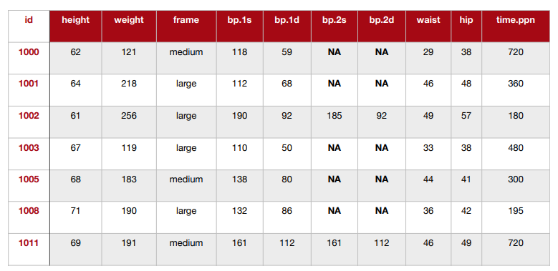
1. Week
19.05.-25.05.
Data cleanup
Removing low variance columns/rows
Removing batch effects
Removing technical outliers
Re-ordering data
Bioinfo-Slides aus dem 3. Semester

Slide 9
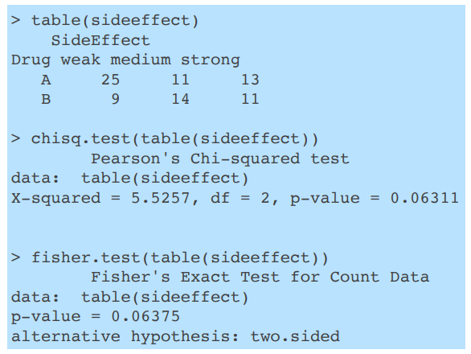
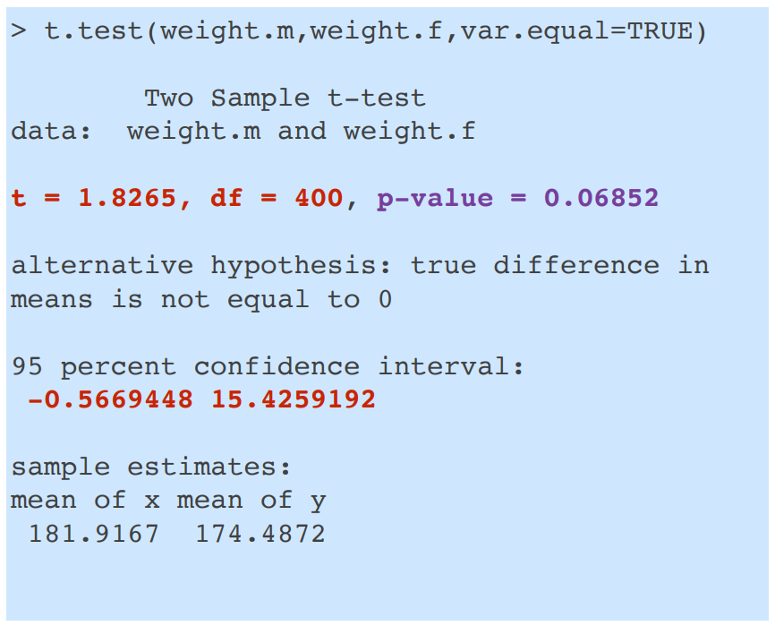
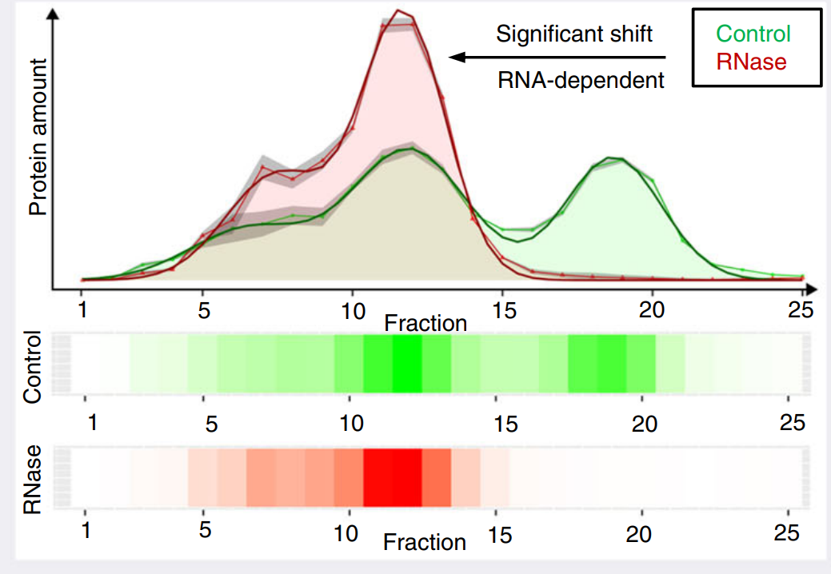
2. Week
26.05.-01.06.
Data exploration
data distribution
t-test
proportion test
Bioinfo-Slides aus dem 3. Semester

Slide 10
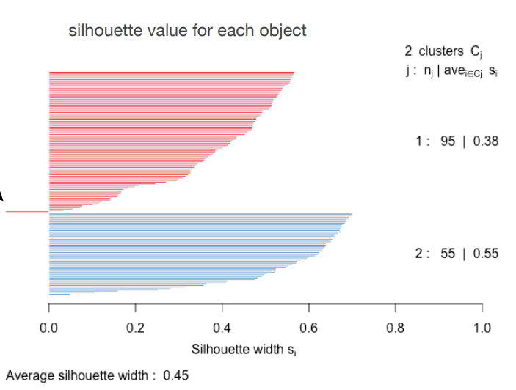
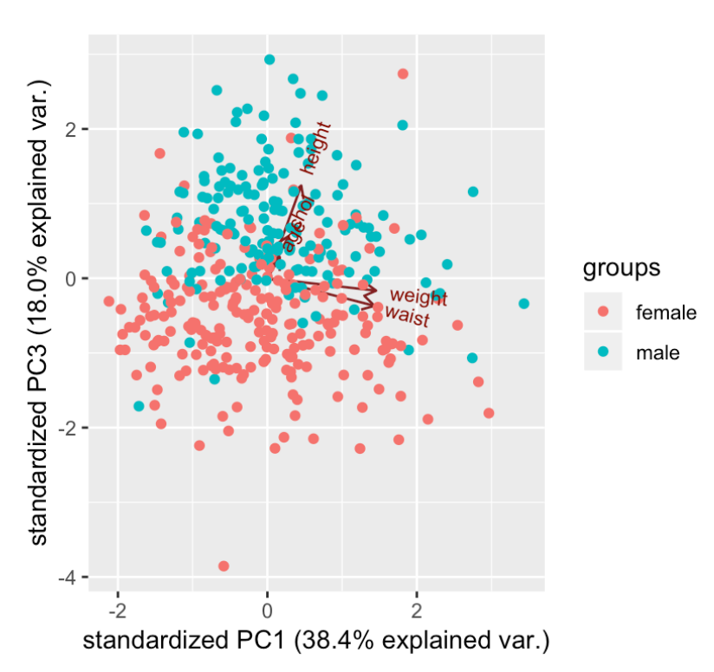
3./4. Week
02.06.-15.06.
Data reduction
PCR
k-means
linear regression analysis
Bioinfo-Slides aus dem 3. Semester

Slide 11
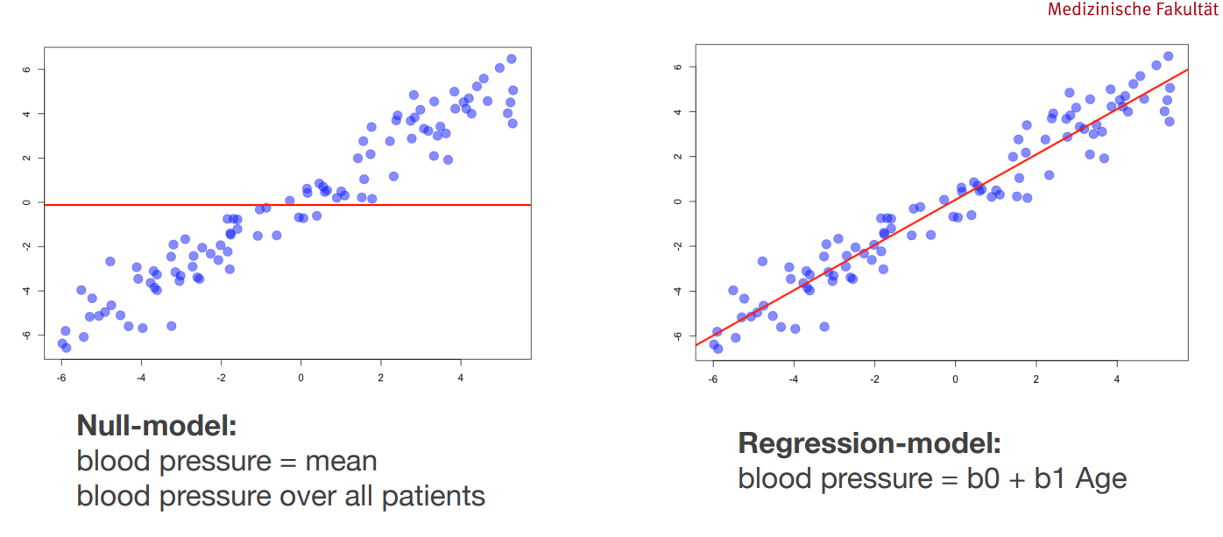
Bioinfo-Slides aus dem 3. Semester

Slide 12
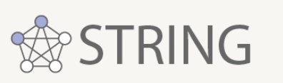

5.-7. Week
16.06.-06.07.
Data modelling
Data presentation
define selection criteria for RNA-dependent proteins
predict whether a protein is a RNA-dependent proteins
poster
final presentation

Slide 13
Thanks for listening

Slide 14
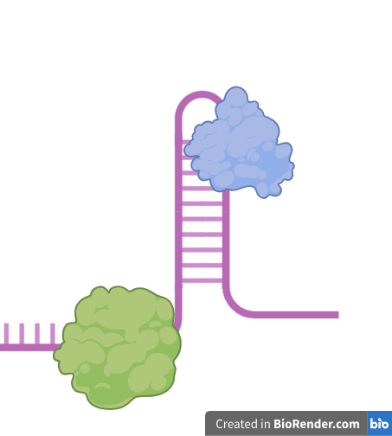
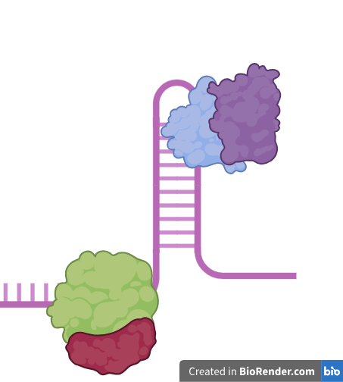
RNA-binding proteins non-synchronized HeLa cells

Slide 15
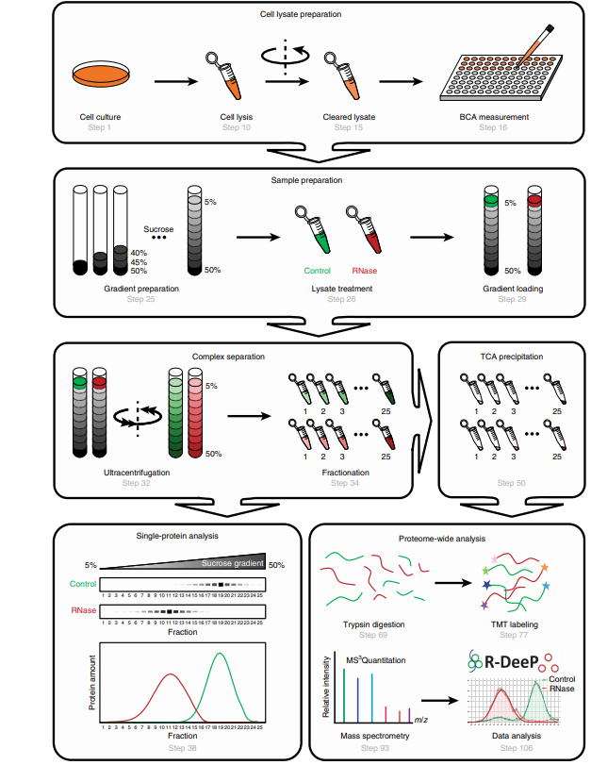
RNA dependence (R-DeeP)
Caudron-Herger et al., Identification, quantification and bioinformatic analysis of RNA-dependent proteins by RNase treatment and density gradient ultracentrifugation using R-DeeP, 2020, Nature Protocols

